Slide 1
Principles of Database Systems (CS307) Lecture 5: More on Join; Set Operators; Subqueries
Ran Cheng
Department of Computer Science and Engineering
Southern University of Science and Technology
Most contents are from slides made by Stéphane Faroult, Dr. Yuxin Ma, and the authors of Database System Concepts (7th Edition).
Their original slides have been modified to adapt to the schedule of CS307 at SUSTech.
Notes:
In this chapter, I will introduce how to retrieve data from one table. Just from one table. I will introduce how to retrieve data from multiple table in next chapter.

Slide 2
More on Join

Slide 3
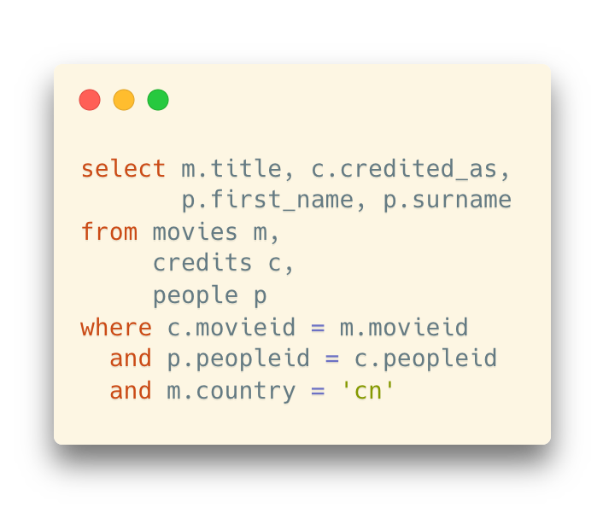
The Old Way of Writing Joins
Use commas to separate the tables
Example: The solution for the same question in the previous slide
A little bit history:
join was introduced in SQL-1999 (later than this original way)
Relationship to the relational algebra
Filtering based on the Cartesian product
movies × credits × people

Slide 4
The Old Way of Writing Joins
The semantic meaning of the where clause here is a little bit different from the where we introduced before
(join key vs. filtering condition)
If you forget where, the query will not return an error but to end up with HUGE amount of rows
#movies * #credits * #people

Slide 5
Inner and Outer Joins
So far, we only consider the rows with matching values on the corresponding columns
However, there are more things you can do with join

Slide 6
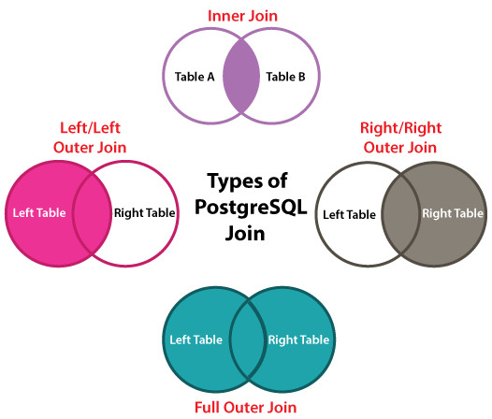
Inner and Outer Joins

Slide 7
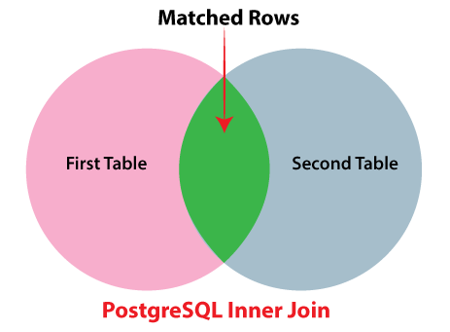
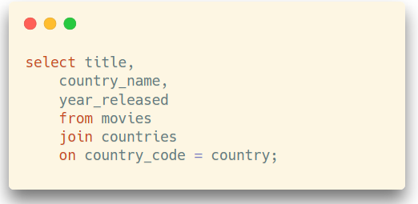
Inner and Outer Joins
Inner join
The default join type
Acturally, all examples before are considered inner joins
Only joined rows with matching values are selected

Slide 8
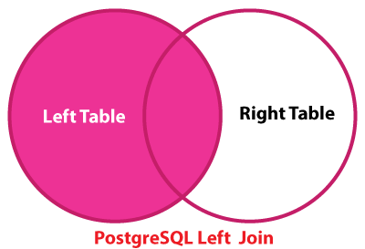
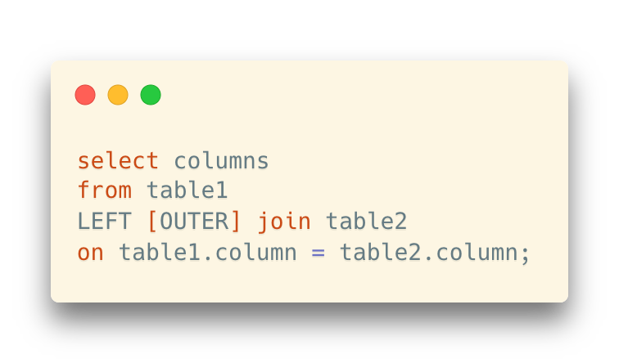
Inner and Outer Joins
Left outer join
All the matching rows will be selected
… and the rows in the left table with no matches will be selected as well

Slide 9
Inner and Outer Joins
Left outer join
Example: there is a movie in 2018 where there is no credit information
#9203 (A Wrinkle in Time)

Slide 10
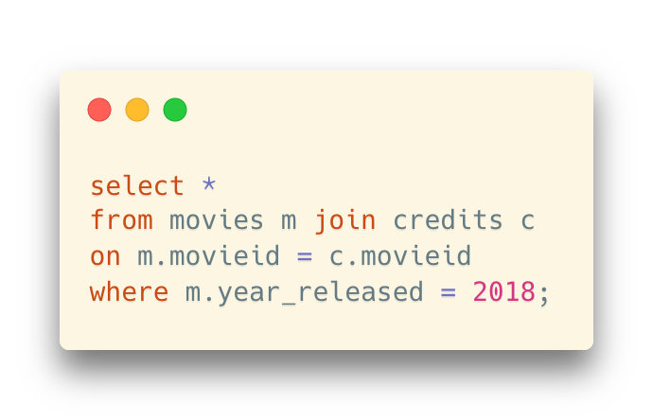
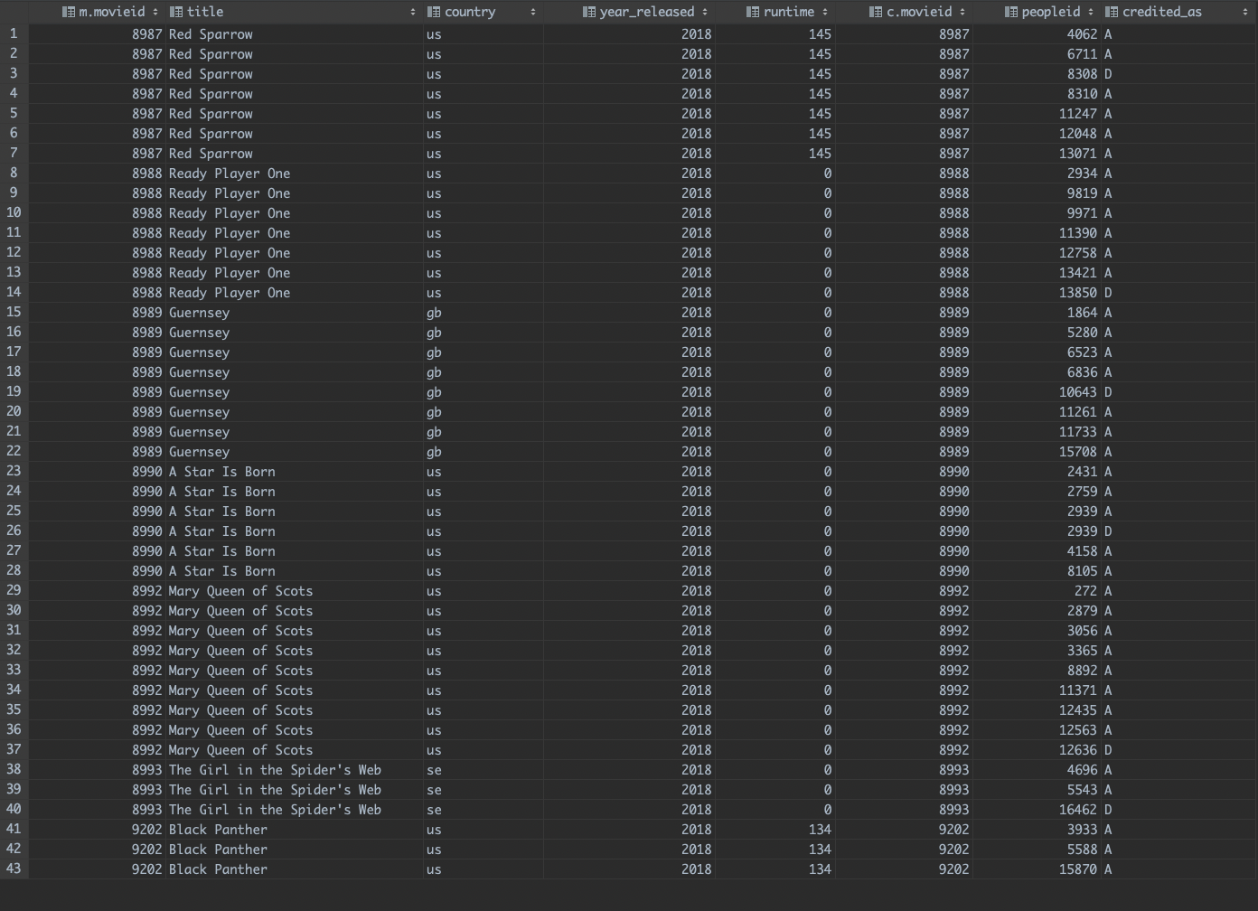
Inner and Outer Joins
Left outer join
Example: there is a movie in 2018 where there is no credit information
#9203 (A Wrinkle in Time)
Inner join of all 2018 movies will not show any matching results for that movie

Slide 11
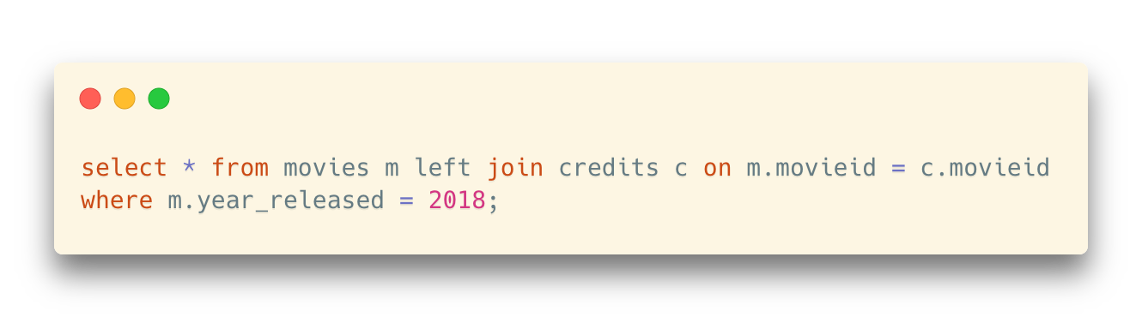
Inner and Outer Joins
Left outer join
Example: there is a movie in 2018 where there is no credit information
#9203 (A Wrinkle in Time)
Inner join of all 2018 movies will not show any matching results for that movie
But, left (outer) join can give you a record for the movie (in the left table) where all right-table columns are null
Pay attention to the syntax:
left join or left outer join
But some databases recognize the outer keyword, some do not. Refer to the database manual if you meet any error.

Slide 12
Inner and Outer Joins
Left outer join
Why? Why should we show the records in the left table with no matches?
Scenario: Movie Website (Douban, for example)
We cannot just ignore the movies with no credit information
Instead, we should list them and also show that credit information is missing
All things can be done in a single query
And we can distinguish between them by checking the values in the right-table columns

Slide 13
Inner and Outer Joins
Left outer join
Another example: let's count how many movies we have per country (again)

Slide 14
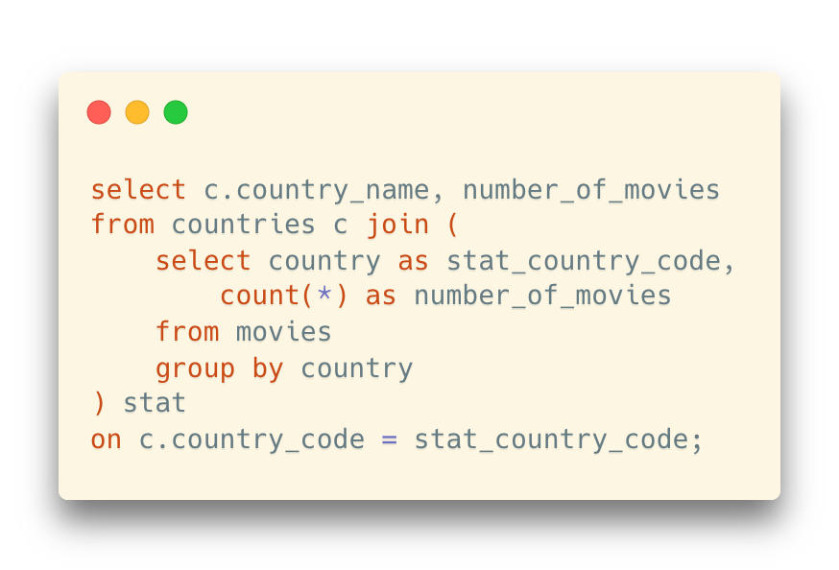
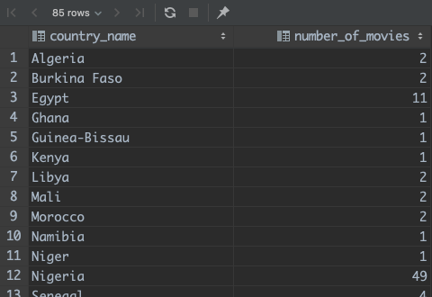
Inner and Outer Joins
Left outer join
Another example: let's count how many movies we have per country (again)
“85 rows”:
Problem
We have ~200 countries in total
How can we show the other countries?

Slide 15
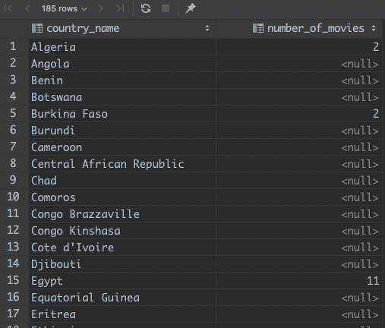
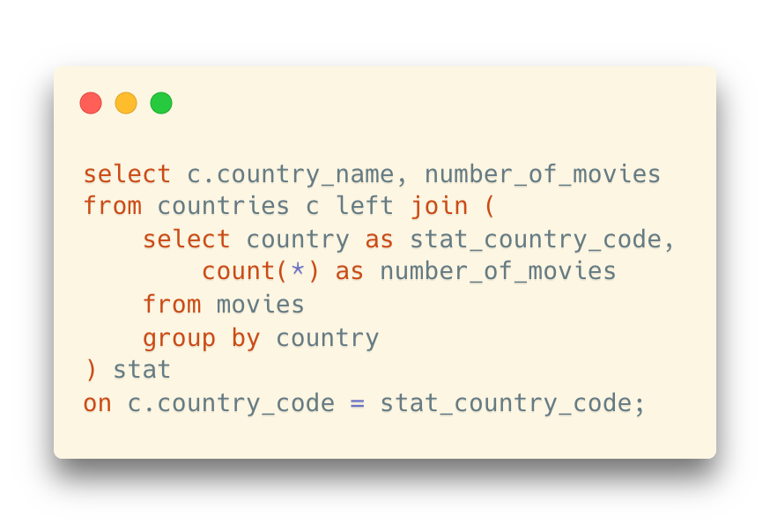
Inner and Outer Joins
Left outer join
All countries are here now
In addition, how can we replace nulls?

Slide 16
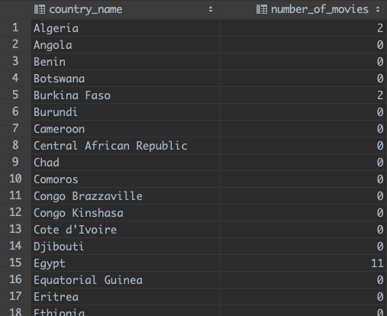
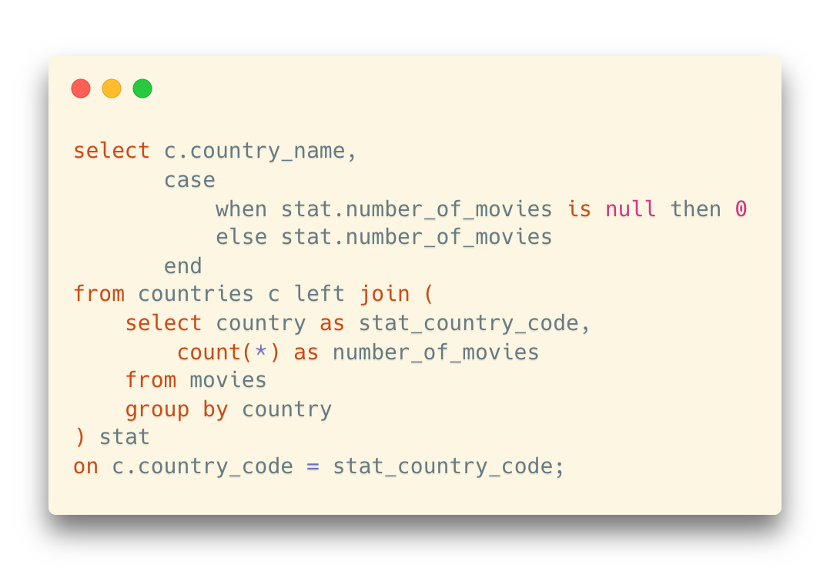
Inner and Outer Joins
Left outer join
All countries are here now
In addition, how can we replace nulls?
Add another CASE condition

Slide 17
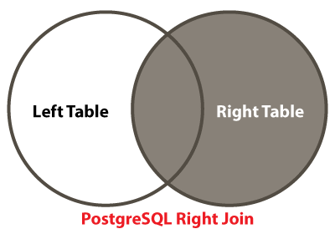
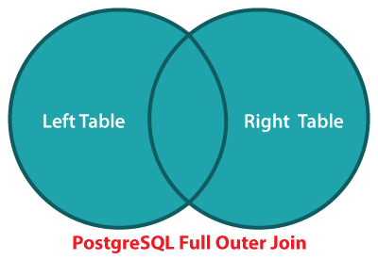
Inner and Outer Joins
Right outer join, full outer join
Books always refer to three kinds of outer joins. Only one is useful and we can forget about anything but the LEFT OUTER JOIN
A right outer join can ALWAYS be rewritten as a left outer join (by swapping the order of tables in the join list)
A full outer join is seldom used

Slide 18
Set Operators

Slide 19
Set Operators
Union
Takes two result sets and combines them into a single result set
Union requires two (commonsensical) conditions:
They must return the same number of columns
The data types of corresponding columns must match.

Slide 20
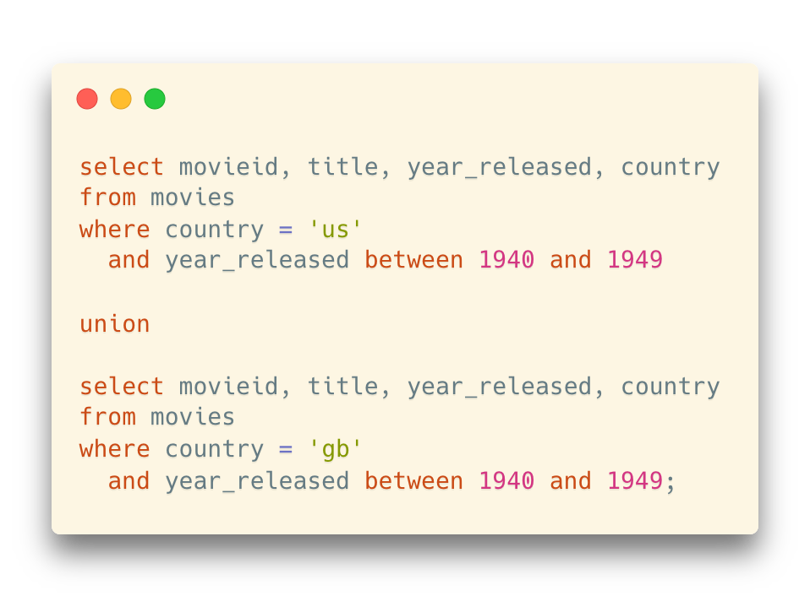
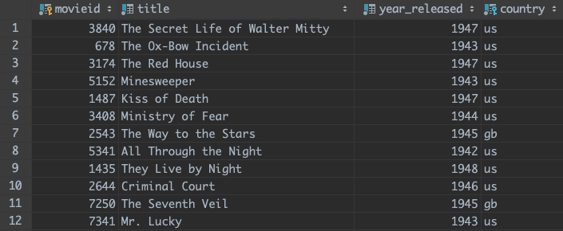
Set Operators
Union
Example: Stack US and GB movies together

Slide 21
Set Operators
Union
Usage scenario: combine movies from two tables, one for standard accounts and one for VIP accounts
We don’t want to miss the “standard movies” for the VIP accounts

Slide 22
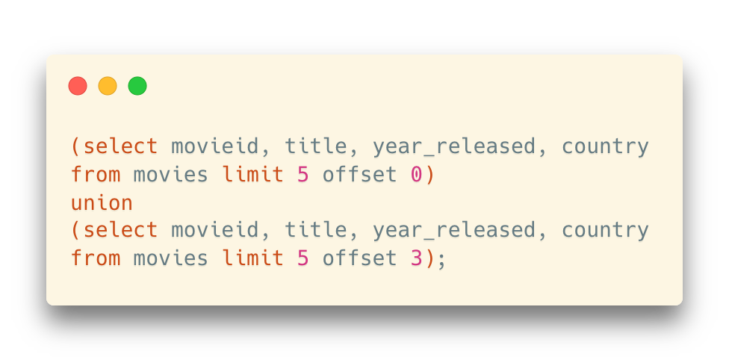
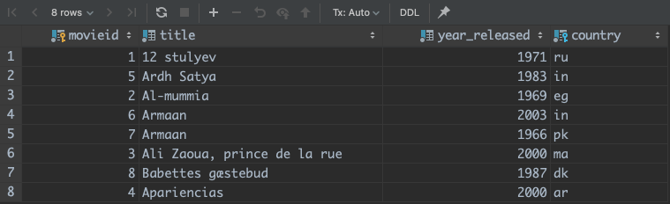
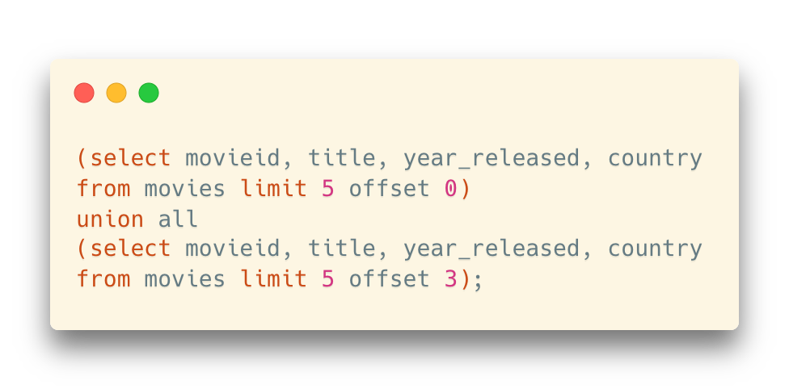
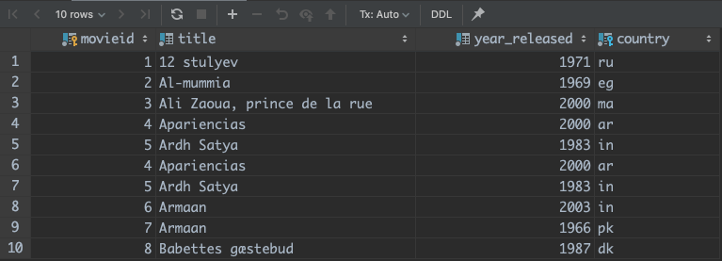
Set Operators
Union
Warning: union will remove duplicated rows
Instead, you can use union all

Slide 23
Set Operators
Intersect (intersect)
Return the rows that appears in both tables
Except (except)
Return the rows that appear in the first table but not the second one
Sometimes written as minus in some database products
However, they are not used as much as union
intersect -> inner join
except -> left outer join with an “is null” condition

Slide 24
Subquery

Slide 25
Subquery
We have used subqueries after from before
… in order to build queries upon a query result
And, we can add subqueries after select and where as well

Slide 26
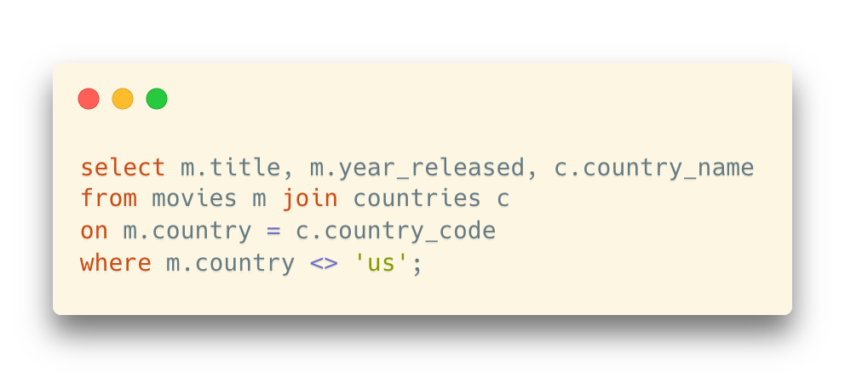

Subquery after Select
Example: show titles, released years, and country names for non-US movies
Solution 1: Join

Slide 27
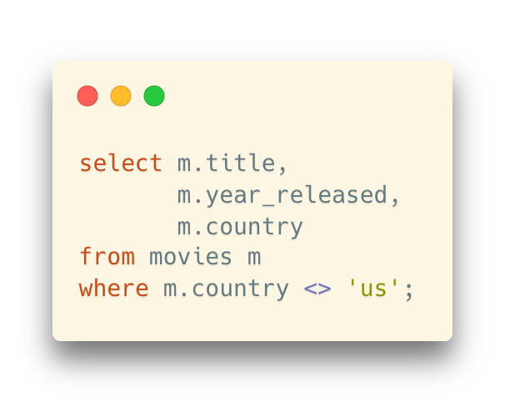
Subquery after Select
Example: show titles, released years, and country names for non-US movies
Solution 2: Nested selection
… still a country code though
How can we replace it with the country name?

Slide 28
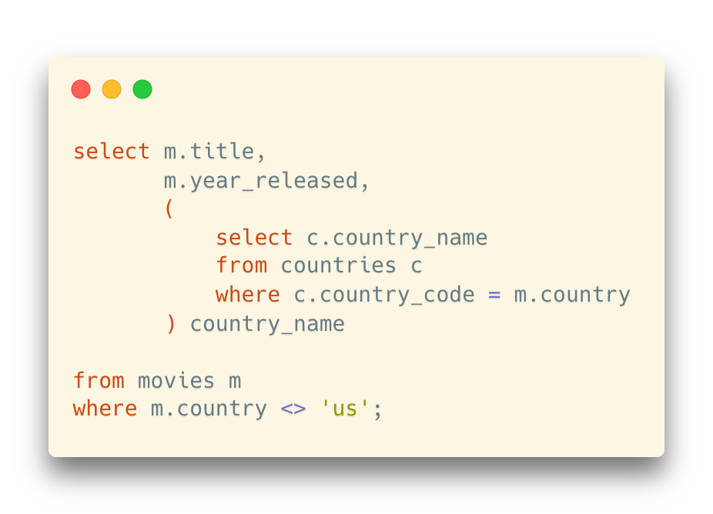
Subquery after Select
Example: show titles, released years, and country names for non-US movies
Solution 2: Nested selection
A subquery after select:
For each selected row in the outer query, find the corresponding country name in the countries table

Slide 29
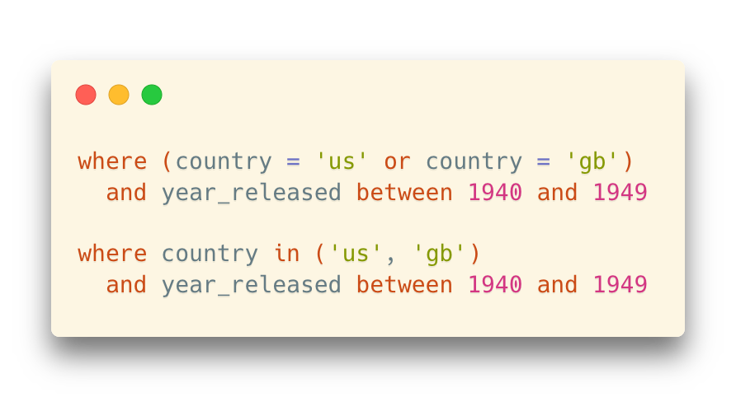
Subquery after Where
Recall: the in() operator
It can be used as the equivalent for a series of equalities with OR (it has also other interesting uses)
It may make a comparison clearer than a parenthesized expression

Slide 30
Subquery after Where
... But in() is far more powerful than this
What is between parentheses may be, not only an explicit list, but also an implicit list of values generated by a query
in (select col
from ...
where ...)

Slide 31
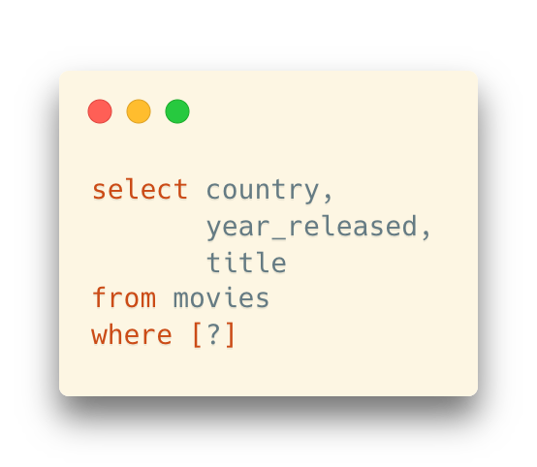
Subquery after Where
Example: Select all European movies
How can we specify the filtering condition?

Slide 32
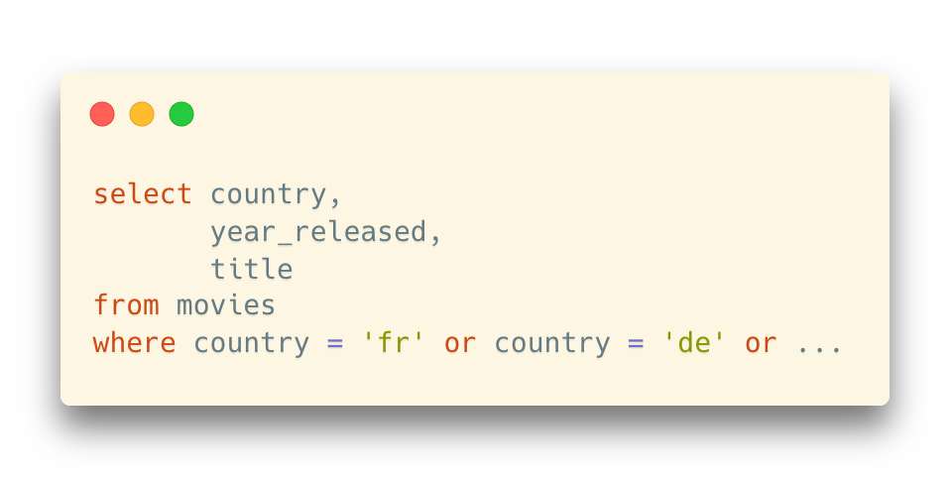

Subquery after Where
Example: Select all European movies
A horrible solution: list all European countries with or

Slide 33
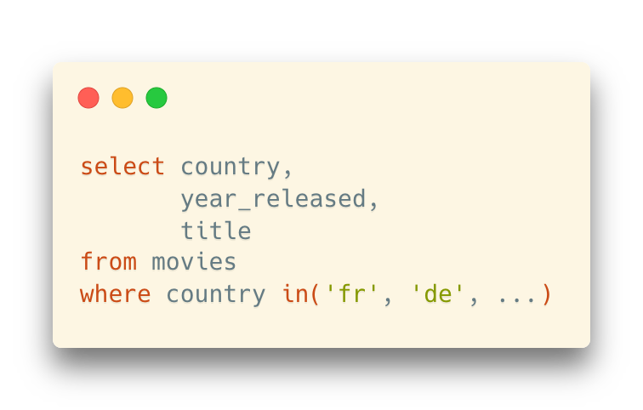
Subquery after Where
Example: Select all European movies
A (slightly better) solution: list all European countries in an in operator

Slide 34


Subquery after Where
Example: Select all European movies
A (slightly better) solution: list all European countries in an in operator

Slide 35
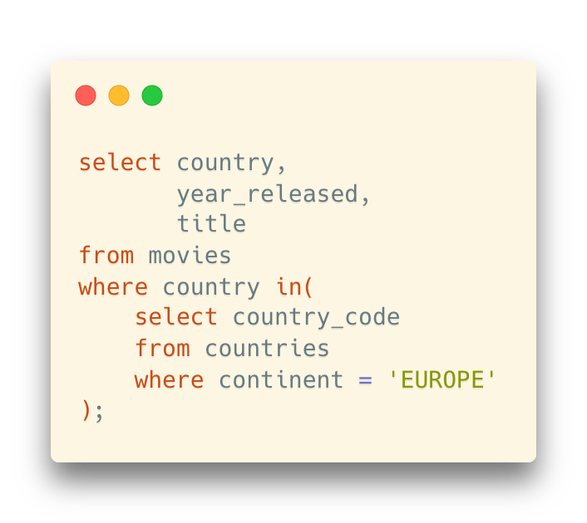

Subquery after Where
Example: Select all European movies
A proper solution: (dynamically) fill in the list of country codes in an in operator
The same results (if you fill in all European country codes on the right side)
But you can automatically generate this list
Especially useful when the table in the subquery changes often

Slide 36
Subquery after Where
Some products (Oracle, DB2, PostgreSQL with some twisting) even allow comparing a set of column values (the correct word is "tuple") to the result of a subquery.
(col1, col2) in
(select col3, col4
from t
where …)

Slide 37
Subquery after Where
Some important points for in()
in() means an implicit distinct in the subquery
in(‘cn’, ‘us’, ‘cn’, ‘us’, ‘us’) is equal to in(‘cn’, ‘us’)

Slide 38
Subquery after Where
Some important points for in()
in() means an implicit distinct in the subquery
in(‘cn’, ‘us’, ‘cn’, ‘us’, ‘us’) is equal to in(‘cn’, ‘us’)
null values in in()
Be extremely cautious if you are using not in(…) with a null value in it

Slide 39
Subquery after Where
Some important points for in()
in() means an implicit distinct in the subquery
in(‘cn’, ‘us’, ‘cn’, ‘us’, ‘us’) is equal to in(‘cn’, ‘us’)
null values in in()
Be extremely cautious if you are using not in(…) with a null value in it
value not in(2, 3, null)
not (value=2 or value=3 or value=null)
value<>2 and value<>3 and value<>null
false -- always false or null, never true
… however, value=null and value<>null are always not true:
We should use is [not] null instead
Thus, the not in() expression always returns false, and hence no row will be selected and returned.

Slide 40
Update and Delete

Slide 41
So Far…
We have learned:
How to access existing data in tables (select)
How to create new rows (insert)
CRUD/CURD
create, read, update, delete
In SQL: insert, select, update, delete
In RESTful API: Post, Get, Put, Delete
Necessary operations for persistent storage

Slide 42
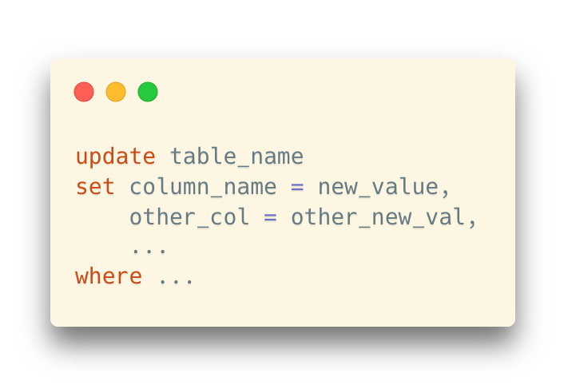
Update
Make changes to the existing rows in a table
update is the command that changes column values
You can even set a non-mandatory column to NULL
The change is applied to all rows selected by the where

Slide 43
Update
Remember
When you are doing any experiments with writing operations (update, delete), backup the data first
E.g., copy the tables

Slide 44
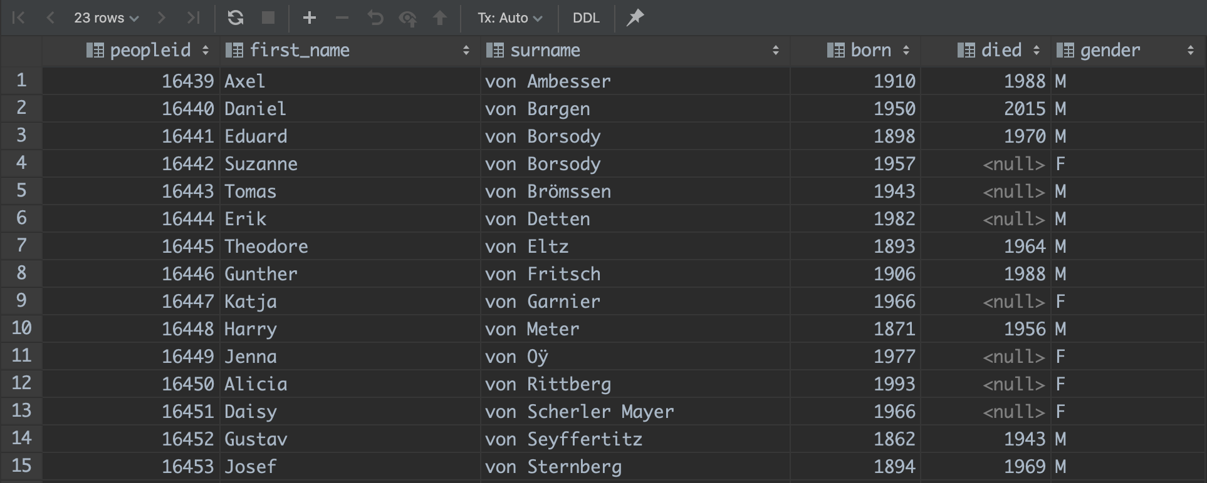
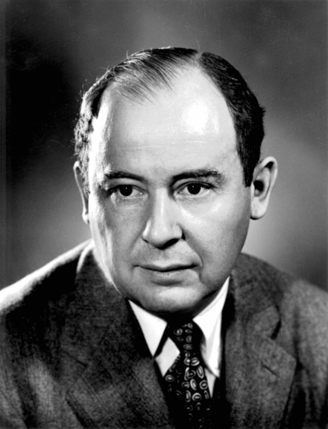
Update
Example: A nobiliary particle is used in a surname or family name in many Western cultures to signal the nobility of a family.
We may want to modify some names in such a way as they sort as they should.
John von Neumann

Slide 45
Update
Example: A nobiliary particle is used in a surname or family name in many Western cultures to signal the nobility of a family.
We may want to modify some names in such a way as they sort as they should.
First, how can we find these names?

Slide 46
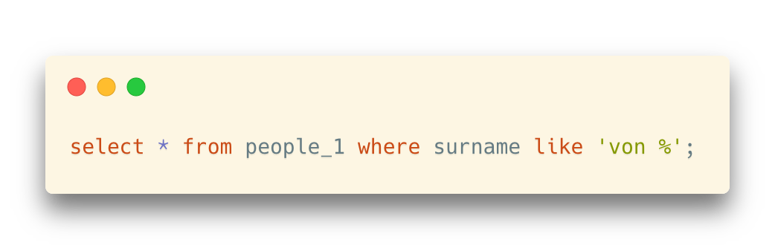
Update
Example: A nobiliary particle is used in a surname or family name in many Western cultures to signal the nobility of a family.
We may want to modify some names in such a way as they sort as they should.
First, how can we find these names?
Wildcards

Slide 47
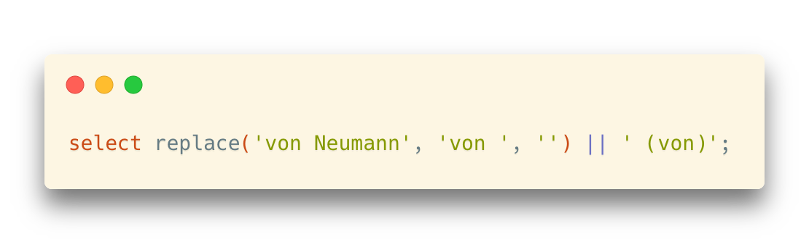
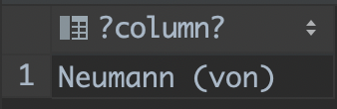
Update
Example: A nobiliary particle is used in a surname or family name in many Western cultures to signal the nobility of a family.
We may want to modify some names in such a way as they sort as they should.
Then, how should we update the names?
Try the transformation with select:
(first_name) John
(surname) von Neumann
(first_name) John
(surname) Neumann (von)

Slide 48
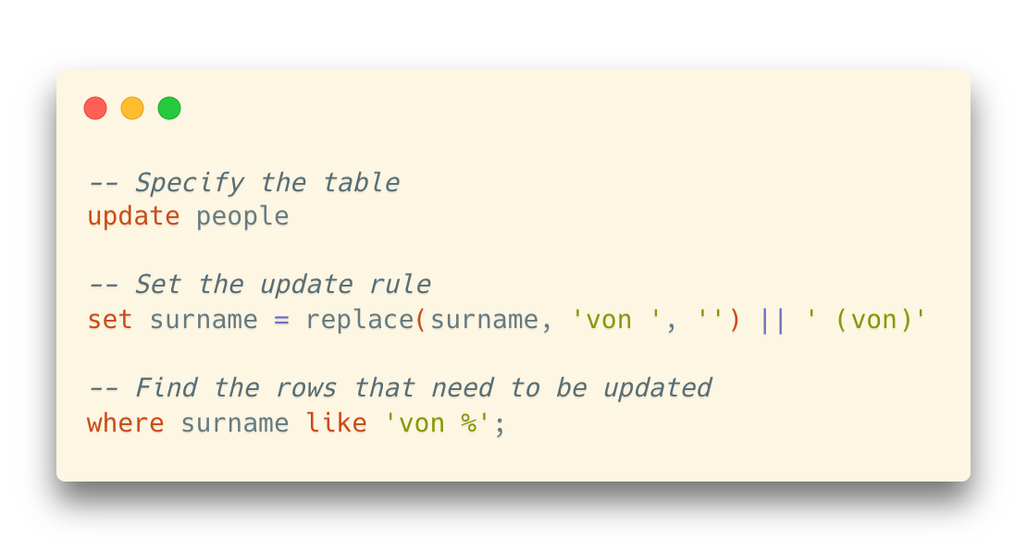
Update
Example: A nobiliary particle is used in a surname or family name in many Western cultures to signal the nobility of a family.
We may want to modify some names in such a way as they sort as they should.
Finally, the update statement:
This could be used to postfix all surnames starting by 'von' with '(von)' and turn for instance 'von Stroheim' into 'Stroheim (von)'

Slide 49
Update
The where clause specifies the affected rows
However, you can use update without where, where the updates will be applied to all rows in the table
Use with caution!
Sometimes, there will be a warning in IDEs such as DataGrip

Slide 50
Update
The update operation may not be successful when constraints are violated
For example, update the primary key but with duplicated values
This is why we need constraints when creating tables: avoid unacceptable writing operations that break the integrity of the tables

Slide 51
Update
Subqueries in update
Complex update operations where values are based on a query result
Example: Add a column in people table to record the number of movies one has joined (either directed or played a role in)

Slide 52
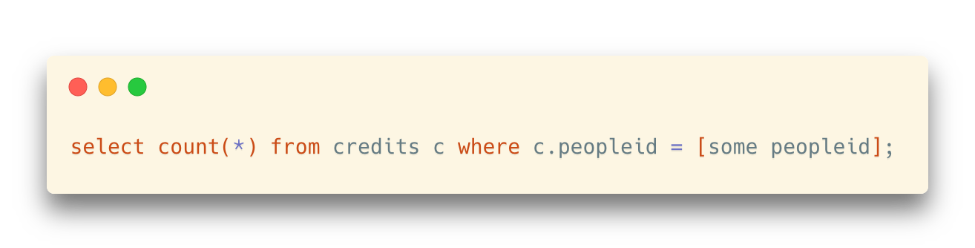
Update
Example: Add a column in people table to record the number of movies one has joined (either directed or played a role in)
First, how do we count the movies for a person?
(Used as the subquery part in the update statement)

Slide 53
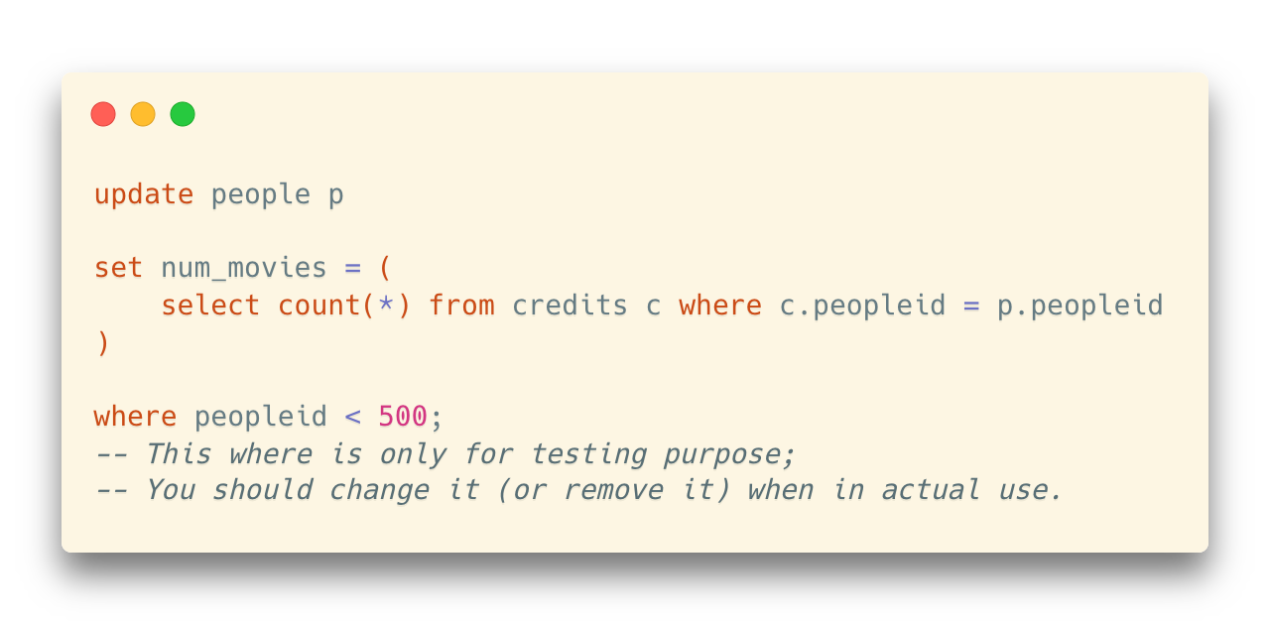
Update
Example: Add a column in people table to record the number of movies one has joined (either directed or played a role in)
First, how do we count the movies for a person?
(Used as the subquery part in the update statement)
Then, let’s update the data

Slide 54
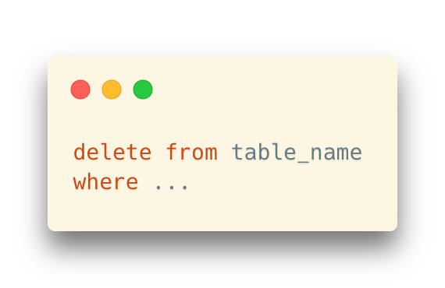
Delete
As the name shows, delete removes rows from tables
If you omit the WHERE clause, then (as with UPDATE) the statement affects all rows and you end up with an empty table!
Well,
many database products provide a roll-back mechanism when deleting rows
Transactions can also protect you (to some extent)

Slide 55
Delete
One important point with constraints (foreign keys in particular) is that they guarantee that data remains consistent
They don't only work with insert, but with update and delete as well.
Example: Try to delete some rows in the country table
Foreign-key constraints are especially useful in controlling delete operations

Slide 56
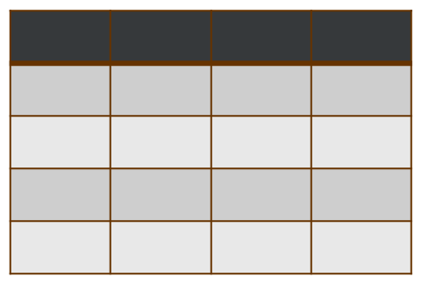

Constraints
This is why constraints are so important:
They ensure that whatever happens, you'll always be able to make sense of ALL pieces of data in your database.
movies
countries
credits
people

